Slide 1
IATS Committee Updates

Slide 2
Connection and Engagement Committee
Committee Members:
Allison Strickland, Chair
Katie Berger
Kayla Tindall
News/Changes in 2023-2024
Updating website with easier links for requests
New Chair – Allison Strickland
Requests
Communicate early and often with requests/asks

Slide 3
Council on Practice Advancement
Committee Members:
Otto Krueger, Chair
Michael Donahue, Rep to MAATA
News/Changes in 2023-24
Requests

Slide 4
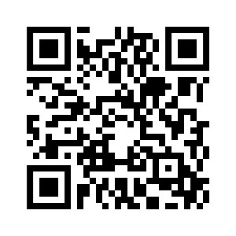
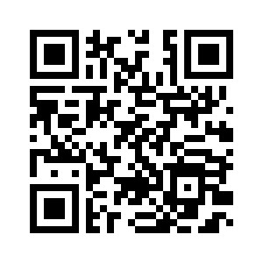
Early Profession Committee & Career Advancement Committee
EPC Committee Members:
Stephanie McKeen, Chair
Kayla Tindall
Gwyneth Phillips
Lauren Runquist
CAC Committee Members:
Jessica Rummery, Chair
Katie Berger
Jennifer Ferden
News/Changes for 2023-24
Student poster presentations at IATS Meeting
Use QR codes to sign up for
Book Club AT Mentor/Mentee

Slide 5
Ethnic Diversity Advisory Committee
Committee Members:
Abu Ibrahim, Chair
Minela Saric
Karina Sanchez
Cameron Nichols
News/Changes in 2023-24
Working through DEI modules to share with state members
Requests

Slide 6
Governmental Affairs Update
Committee Members:
Lisa Bengtson, Chair
Melanie Mason
Otto Kruger
Kaitlin Hora
Jennie Sertterh
Christopher Fagerness
News/Changes in 2023-24
Board & Commissions Review Committee
Legislation amended to NOT modify Board of AT
Monitoring changes to transitional coaching license
Want CPR/AED training required
Requests
Continue to communicate with
local legislators

Slide 7
Honors & Awards Committee
Committee Members:
Richelle Williams, Chair
Lisa Bengtson
Jessica Rummery
Megan Brady
Natasha Schmitter
Kelli Snyder
Kara Gange
News/Changes in 2023-24
Implemented new awards cycle
Reviewed and updated awards criteria
Requests
Submit nominations (can do this now)
Iats.scholarships@gmail.com

Slide 8
Professional Education & Research Committee
Committee Members:
Chris Viesselman, Chair
Molly Figgins
Mark Hecimovich
News/Changes in 2023-24
First research grant given out
Presenting during IATS Meeting
Requests
Call for research grant proposals in fall 2024

Slide 9
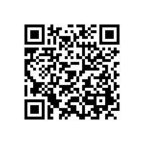
Secondary Schools Committee
Committee Members:
Rhianna Freiburger, Co-Chair
Ashley Dickey, Co-Chair
Kalene Voorhees
Brandon Church
Jennifer McHenry
Jon Hochstelter
Anna Manternach
Kelsi Huseman
Logan Wood
News/Changes for 2023-24
Monitoring and participating in TUFSS meeting hosted by Korey Stringer Institute in April
Requests
Use QR code to complete Atlas Survey

Slide 10
Student Leadership Council
Committee Members:
Megan Brady, Mentor
President – Caitlin Farrell, Loras
VP – Faye Witkowski – ISU
Treasurer – Amanda Williams, Loras
Secretary – Elizabeth Sutton Mason, Iowa
News/Changes in 2023-24
Iowa and Iowa State students won state quiz bowl – Congrats to Iowa State on advancing to the national competition.
Leaders for next year elected.
Requests
None currently

Slide 11
Iowa Athletic Training Society
Business Meeting
April 2024
IATS Annual Meeting
West Des Moines, IA

Slide 12
Past-President Update
Accomplishments of the Past 2 Years
Internally
Reformatted/Reorganized essential IATS documents
Reorganization of IATS structure and functions
Revised IATS Mission and Vision statements and organizational Values
Externally
Initial work on future legislation
School district emergency planning
Communicating with stakeholders regarding future endeavors
Defended state licensure board and AT license
Defended for the protection of Iowa high school athletes
Coaches’ education and training bills

Slide 13
Thank Yous
Thanks go to a great Executive Committee and group of committee chairs that continue to evolve.
Appreciate the confidence and opportunity to represent the organization for the past 2 years.

Slide 14
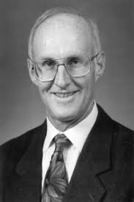
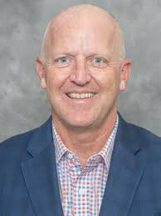
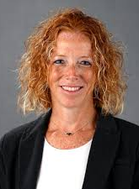
First Thoughts
Thanks to Past-Presidents Miller, Viel, Floy, and Neu
Thanks to those I learned about professional service from
Be very careful when you start down a professional service path
Much more later this afternoon

Slide 15
Special Introductions
NATA Hall of Famers
Frank Mann, Charles Randall, Kent Falb, Larry Leverenz, Terry Noonan, Mark Coberley
MAATA Hall of Famers
Doug West, Diane Bartholomew, Mark Coberley, Stephen Knoche, John Roslien, Terry Noonan, Ed Crowley, & Dan Foster
IATS Hall of Honor Inductees
Mary Meier, Eric Knudson, Troy Kleese, Jill White, Kurt Flathers, Jennifer McHenry, Diane Bartholomew, Doug West, Mark Coberley, Marty Anderegg, Steve Knoche, Alan Beste, John Strief, Paul Flynn, Betty Hoff, John Roslien, Shaun McCarthy, Terry Noonan, Warren Ariail, Ed Crowley, Arthur Dickinson, Roger Egland, Dan Foster, Charles Randall, Reggie Speak
Yearly Award Winners
Rihanna Freiburger (Career Advancement Committee National Distinction Award)
Sean Rogers (MAATA Young Professional Award of Distinction)
Quiz Bowl
Iowa State University (1st in state, 1st at MAATA)
University of Iowa (2nd in state)

Slide 16
President’s Update
Legislative Update
Thank to you the membership!
Thanks to Past-President Miller!
Membership in IATS and NATA
Very quickly, this could be the largest threat to our professional organizations
Impacts our voice at the national level

Slide 17
President’s Update
Team Up For Sport Safety (TUFFS) Meeting
Hosted by Korey Stringer Institute
Held in Ames in late April
Will be used as starting point for Sports Medicine Advisory Committee and policy changes/recommendations for secondary schools
Town Hall and Meeting Future
Please attend, be willing to participate and share

Slide 18
President Elect Update
Working on understanding:
Where IATS is
Where it needs to go
How will strategic plan be continued after 2 years
Vision of:
Member focused
Open door policy
Member mentorship/appreciation

Slide 19
Treasurer Update
2023 Taxes Completed – 990 Form made available to EC​
If you know someone who isn’t an NATA member – please tell them that 25% of your NATA dues, comes back to the state​
Corporate Sponsorships – try to connect virtual events offered by IATS with sponsors - increase partnerships across the state​
Please email Treasurer if you have contacts of possible sponsors for IATS​
Annual Meeting in April – may see a slight increase in cost due to hospitality cost increases. ​
Included this year with your registration fee:​
All food and non-alcoholic beverages ​
Around 11 CEUs – with a casting lab​
January 1 – December 31, 2023
Total Income
$22,647.95
25% of NATA Dues = $11,908.52
IATS Annual Mtg Reg = $5,105
Total Expenses $23,283.06
Lobbyist = $10,010
Annual Mtg = $5,910
IATS Sponsors = $2,400
Committees = $1,107
Operational = $2,000
Scholarships/Grants = $3,187
Net Loss = $635.11

Slide 20
Current Finances – March 2024

Slide 21
MAATA Update
Future MAATA Meetings
March 13-15, 2025 in LaVista, NE
March 2026 in DES MOINES!!
Any companies interested in advertising using
Multiview?

Slide 22
Special Notes & Requests from Committees
Book Club Sign Up Mentor/Mentee Program Sign Up
Award Nominations
Do this NOW! – Just need to submit a name to iats.scholarships@gmail.com

Slide 23
Special Notes & Requests from Committees
Complete ATLAS Survey

