Slide 1
Connection and Engagement Committee
Committee Members:
Allison Strickland, Chair
Katie Berger
Kayla Tindall
News/Changes in 2023-2024
Updating website with easier links for requests
New Chair – Allison Strickland
Requests
Communicate early and often with requests/asks

Slide 2
Council on Practice Advancement
Committee Members:
Otto Krueger, Chair
Michael Donahue, Rep to MAATA
News/Changes in 2023-24
Requests

Slide 3
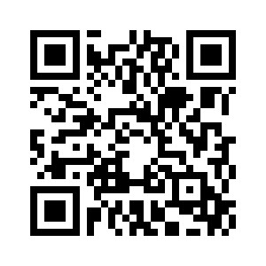
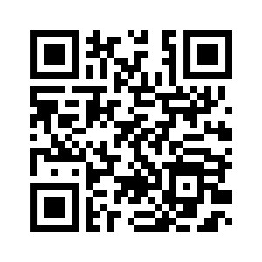
Early Profession Committee & Career Advancement Committee
EPC Committee Members:
Stephanie McKeen, Chair
Kayla Tindall
Gwyneth Phillips
Lauren Runquist
CAC Committee Members:
Jessica Rummery, Chair
Katie Berger
Jennifer Ferden
News/Changes for 2023-24
Student poster presentations at IATS Meeting
Use QR codes to sign up for
Book Club AT Mentor/Mentee

Slide 4
Ethnic Diversity Advisory Committee
Committee Members:
Abu Ibrahim, Chair
Minela Saric
Karina Sanchez
Cameron Nichols
News/Changes in 2023-24
Lining up “Be the Match” for IATS Meeting
Working through DEI modules to share with state members
Requests

Slide 5
Governmental Affairs Update
Committee Members:
Lisa Bengtson, Chair
Melanie Mason
Otto Kruger
Kaitlin Hora
Jennie Sertterh
Christopher Fagerness
News/Changes in 2023-24
Board & Commissions Review Committee
Legislation amended to NOT modify Board of AT
Monitoring changes to transitional coaching
Want CPR/AED training required
Requests
Continue to communicate with
local legislators

Slide 6
Honors & Awards Committee
Committee Members:
Richelle Williams, Chair
Lisa Bengtson
Jessica Rummery
Megan Brady
Natasha Schmitter
Kelli Snyder
Kara Gange
News/Changes in 2023-24
Implemented new awards cycle
Reviewed and updated awards criteria
Requests
Submit nominations (can do this now)
Iats.scholarships@gmail.com

Slide 7
Professional Education & Research Committee
Committee Members:
Chris Viesselman, Chair
Molly Figgins
Mark Hecimovich
News/Changes in 2023-24
First research grant given out
Requests
Call for research grant proposals in fall 2024

Slide 8
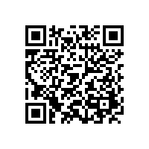
Secondary Schools Committee
Committee Members:
Rhianna Freiburger, Chair
Kalene Voorhees
Brandon Church
Jennifer McHenry
Jon Hochstelter
Ashley Dickey
Anna Manternach
Kelsi Huseman
Logan Wood
News/Changes for 2023-24
Monitoring and participating in TUFSS meeting hosted by Korey Stringer Institute in April
Requests
Use QR code to complete Atlas Survey

Slide 9
Student Leadership Council
Committee Members:
Megan Brady, Mentor
President – Caitlin Farrell, Loras
VP – Faye Witkowski – ISU
Treasurer – Amanda Williams, Loras
Secretary – Elizabeth Sutton Mason, Iowa
News/Changes in 2023-24
Iowa and Iowa State students won state quiz bowl
Selecting leaders for next year in March.
Requests
Nominations for leadership positions due end of week

Slide 10
President’s Update
Legislative Session Update
BCRC Update
Monitoring bill related to transitional coaching licensure and training
IATS Elections
Congratulations to newly elected Executive Committee Members
President-Elect – Jessica Rummery – Bettendorf High School
Treasurer – Rick Loutsch – Northwestern College
Secretary – Tyler Patterson – Iowa State University

Slide 11
President’s Update
Actively reaching out to non-NATA members in the state about membership in IATS/NATA
25% of dues come back to state
Team Up For Sport Safety (TUFFS) Meeting
Hosted by Korey Stringer Institute
Held in Ames in April
Will be used as starting point for Sports Medicine Advisory Committee and policy changes/recommendations for secondary schools

Slide 12
President-Elect Update
Town Halls
Held one in Iowa City
2nd at MAATA
Final one at IATS Meeting in April
New Operating Calendar
August-May operating calendar
Efficient and matches practice

Slide 13
Treasurer Update
2023 Taxes Completed – 990 Form made available to EC​
If you know someone who isn’t an NATA member – please tell them that 25% of your NATA dues, comes back to the state​
Corporate Sponsorships – try to connect virtual events offered by IATS with sponsors - increase partnerships across the state​
Please email Treasurer if you have contacts of possible sponsors for IATS​
Annual Meeting in April – may see a slight increase in cost due to hospitality cost increases. ​
Included this year with your registration fee:​
All food and non-alcoholic beverages ​
Around 11 CEUs – with a casting lab​
January 1 – December 31, 2023
Total Income
$22,647.95
25% of NATA Dues = $11,908.52
IATS Annual Mtg Reg = $5,105
Total Expenses $23,283.06
Lobbyist = $10,010
Annual Mtg = $5,910
IATS Sponsors = $2,400
Committees = $1,107
Operational = $2,000
Scholarships/Grants = $3,187
Net Loss = $635.11

Slide 14
Current Finances – March 2024

Slide 15
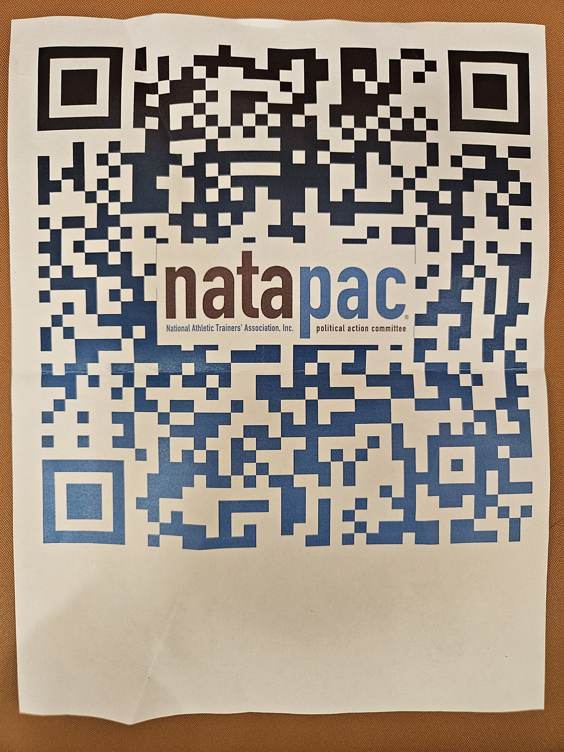
MAATA Update
Future MAATA Meetings
March 13-15, 2025 in LaVista
March 2026 in DES MOINES!!
Any companies interested in advertising using
Multiview?
Grassroots effort for NATA membership
Need an Iowa representative to MAATA
Scholarship Committee

